Slide 1
A Two DoF Self Adaptive Bionic Ankle
Justin Guo

Slide 2
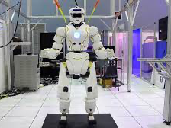
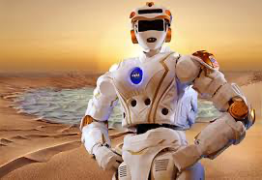
Background Signficance and Proposal
In rough terrains, we are not going to build flat roads during our exploration. We need robots that focuses on movement ability, including the ability to move through rough terrain and great cliffs. These robots are taking the role to going on a mission to rescue in wild environments, and in rubbles.
The machinery need to stabilize and adapt to the unknown surroundings.
Proposal: A good leg, or more specific, a good ankle will help the machinery to traverse better in rough environments.

Slide 3
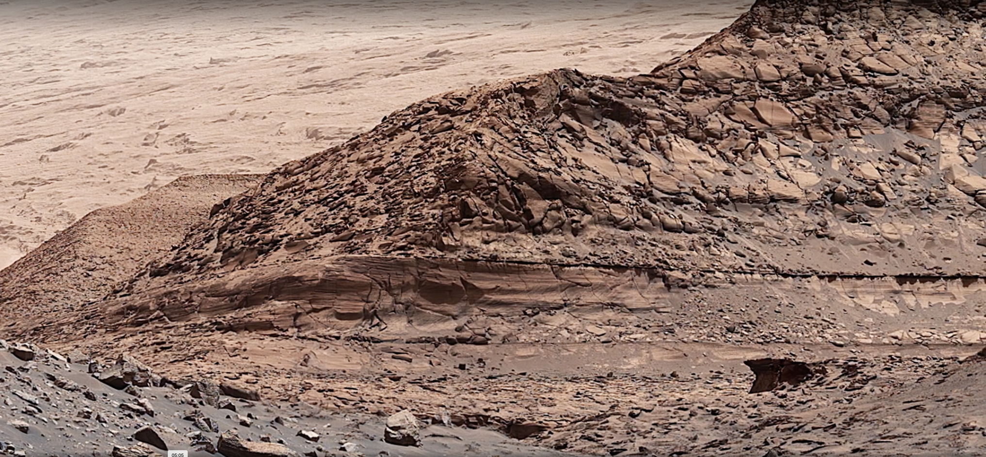
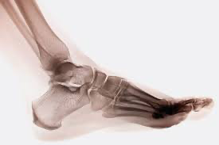
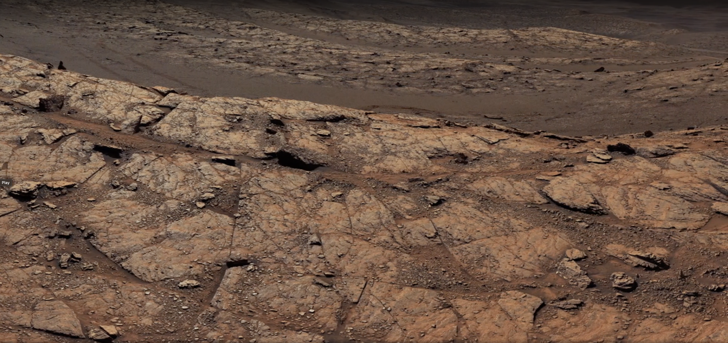
Why Human Ankle?
I need an ankle, allowing 2 dimensional movement, that have the ability to travel in all kinds of terrain.
Human ankle:
exceled at self adapting to different environment,
is stable in these different environments,
and is energy efficent

Slide 4
Innovation and Challenges
Which will include:
an additional motor to control not only the leg's dorsiflexion and plantar flexion, but also inversion and eversion movement of an ankle in human leg
a self adaptive program for it to aid movement
the usage of motor system to simulate the muscles in human leg
the usage of springs to simulate the shock absorption mechanics in human leg
Challenges:
1. Mechanical Structure: How are the two motors in the ankle goint to be placed?
2. Reaction to the Ground: How does the bionic ankle sense the ground?
3. Connection: How should the motors and the sensors collborate?

Slide 5
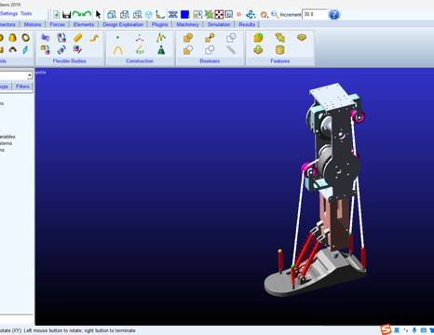
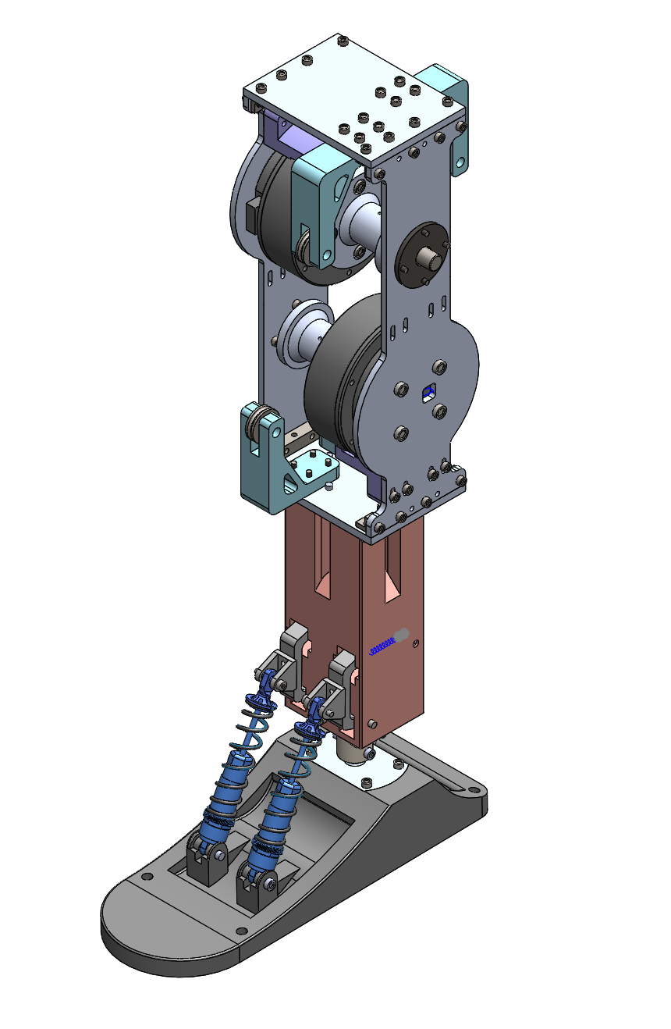
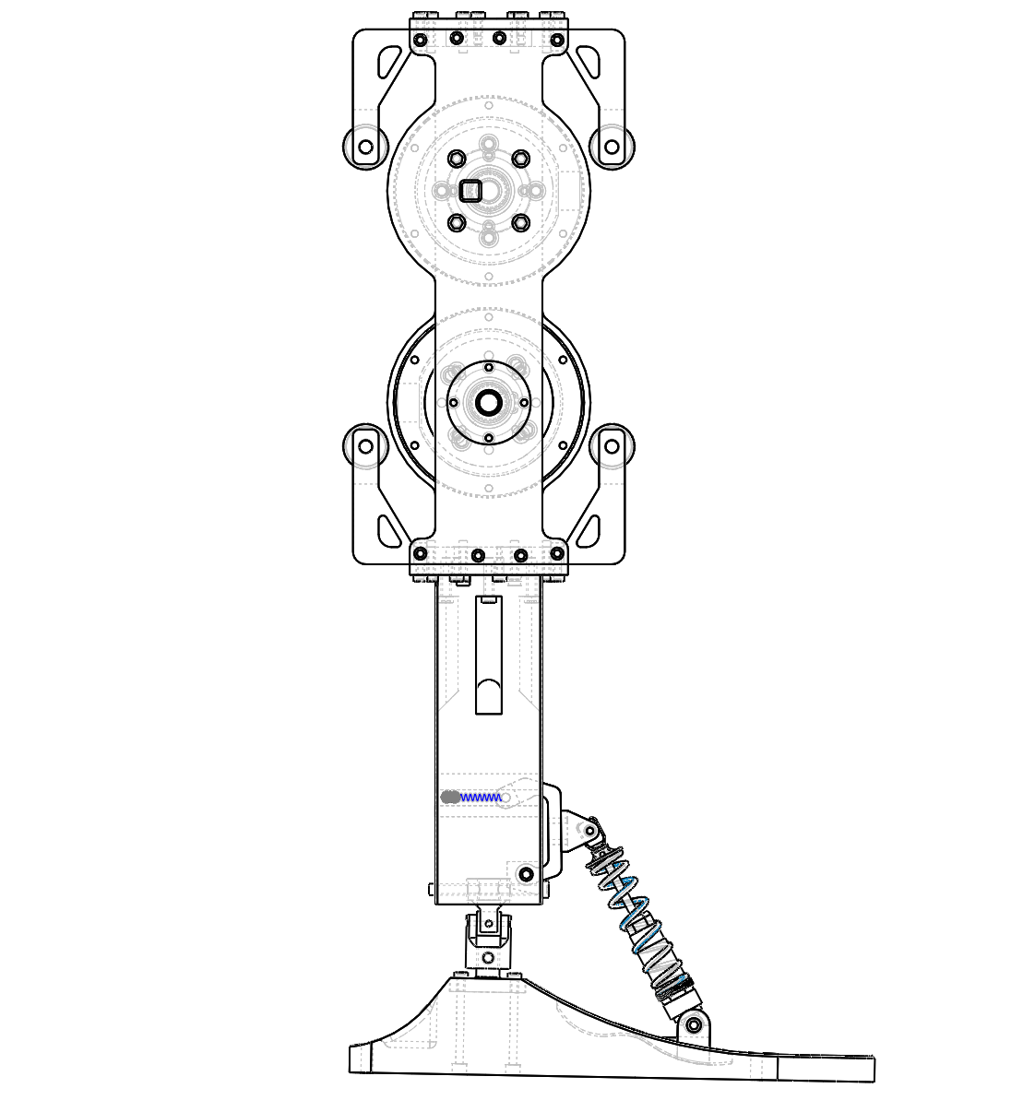
Structural Design
Use Solidworks to plan out the whole structure and record the parts needed to build the whole structure.
Motor-string system to balance the weight of the object
Usage of springs to absorb shock
3.17 – 3.31

Slide 6
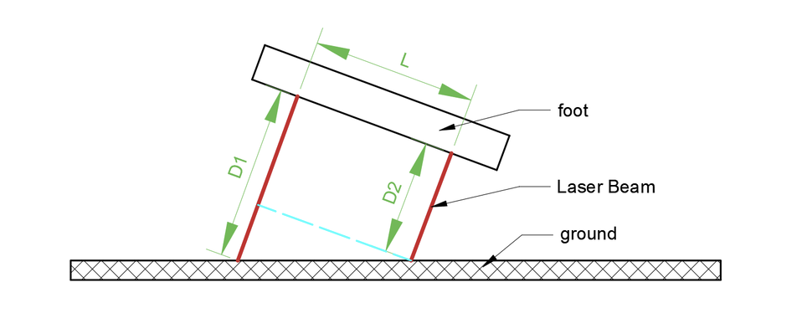
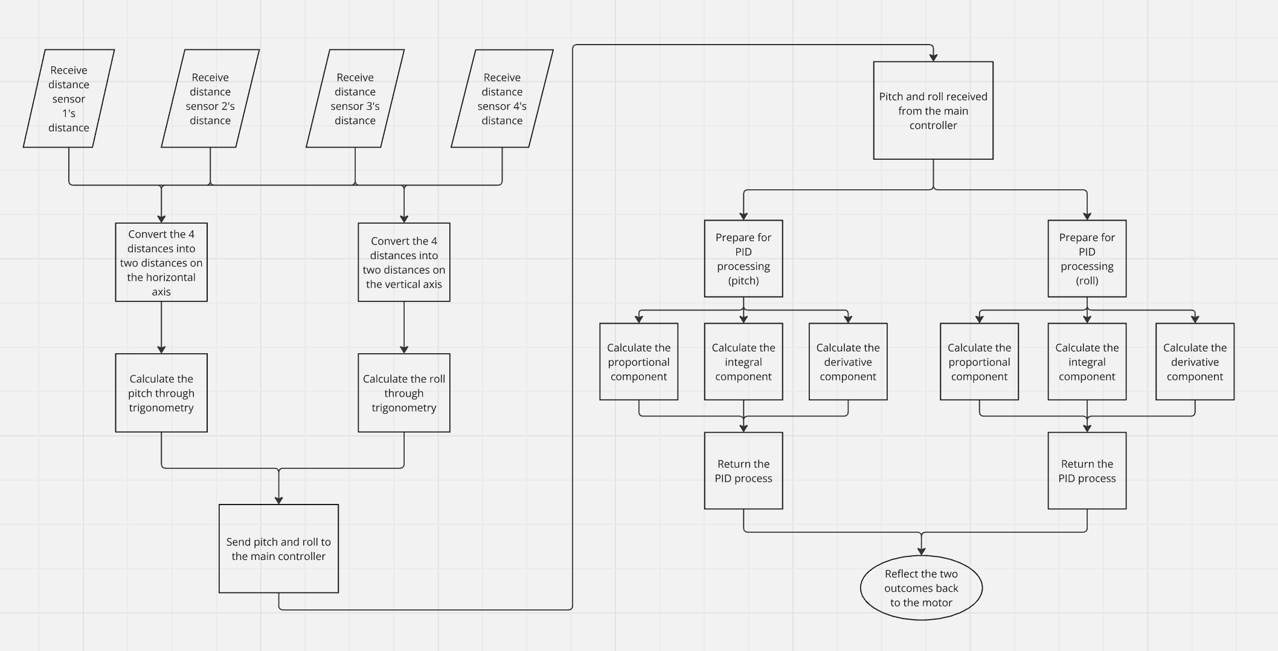
Software Programming
The laser distance sensors is implemented with the right diagram.
The PID controller will self-adjust the two angles, roll and pitch to quickly and efficiently adjust the angle of the foot, making it parallel to the ground.

Slide 7
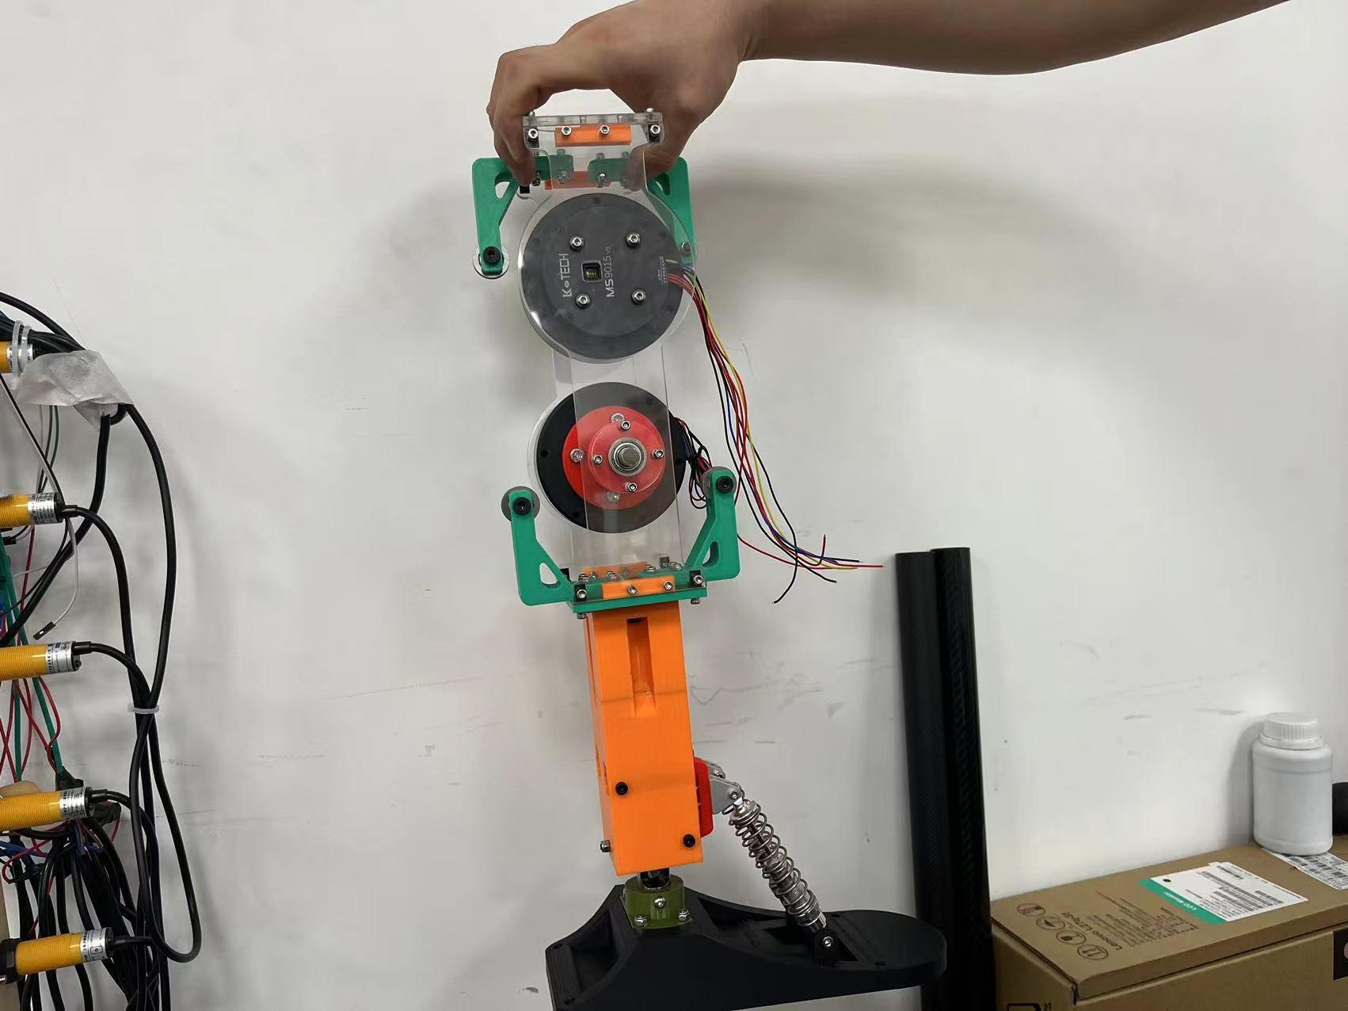
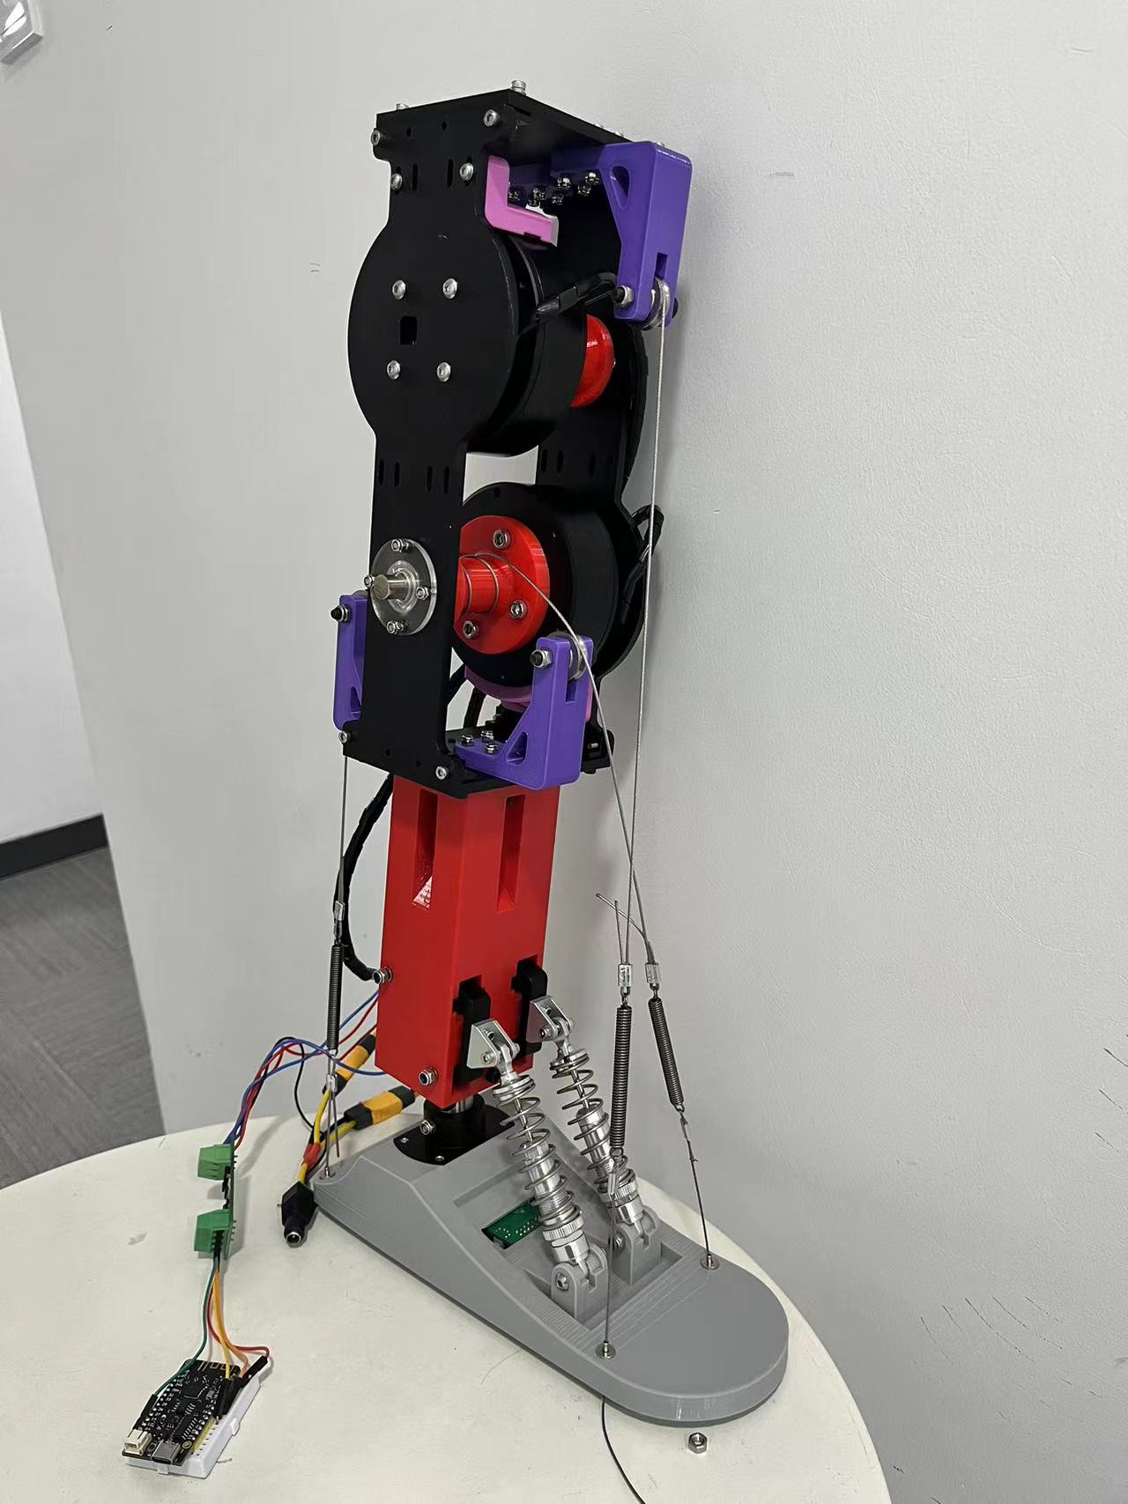
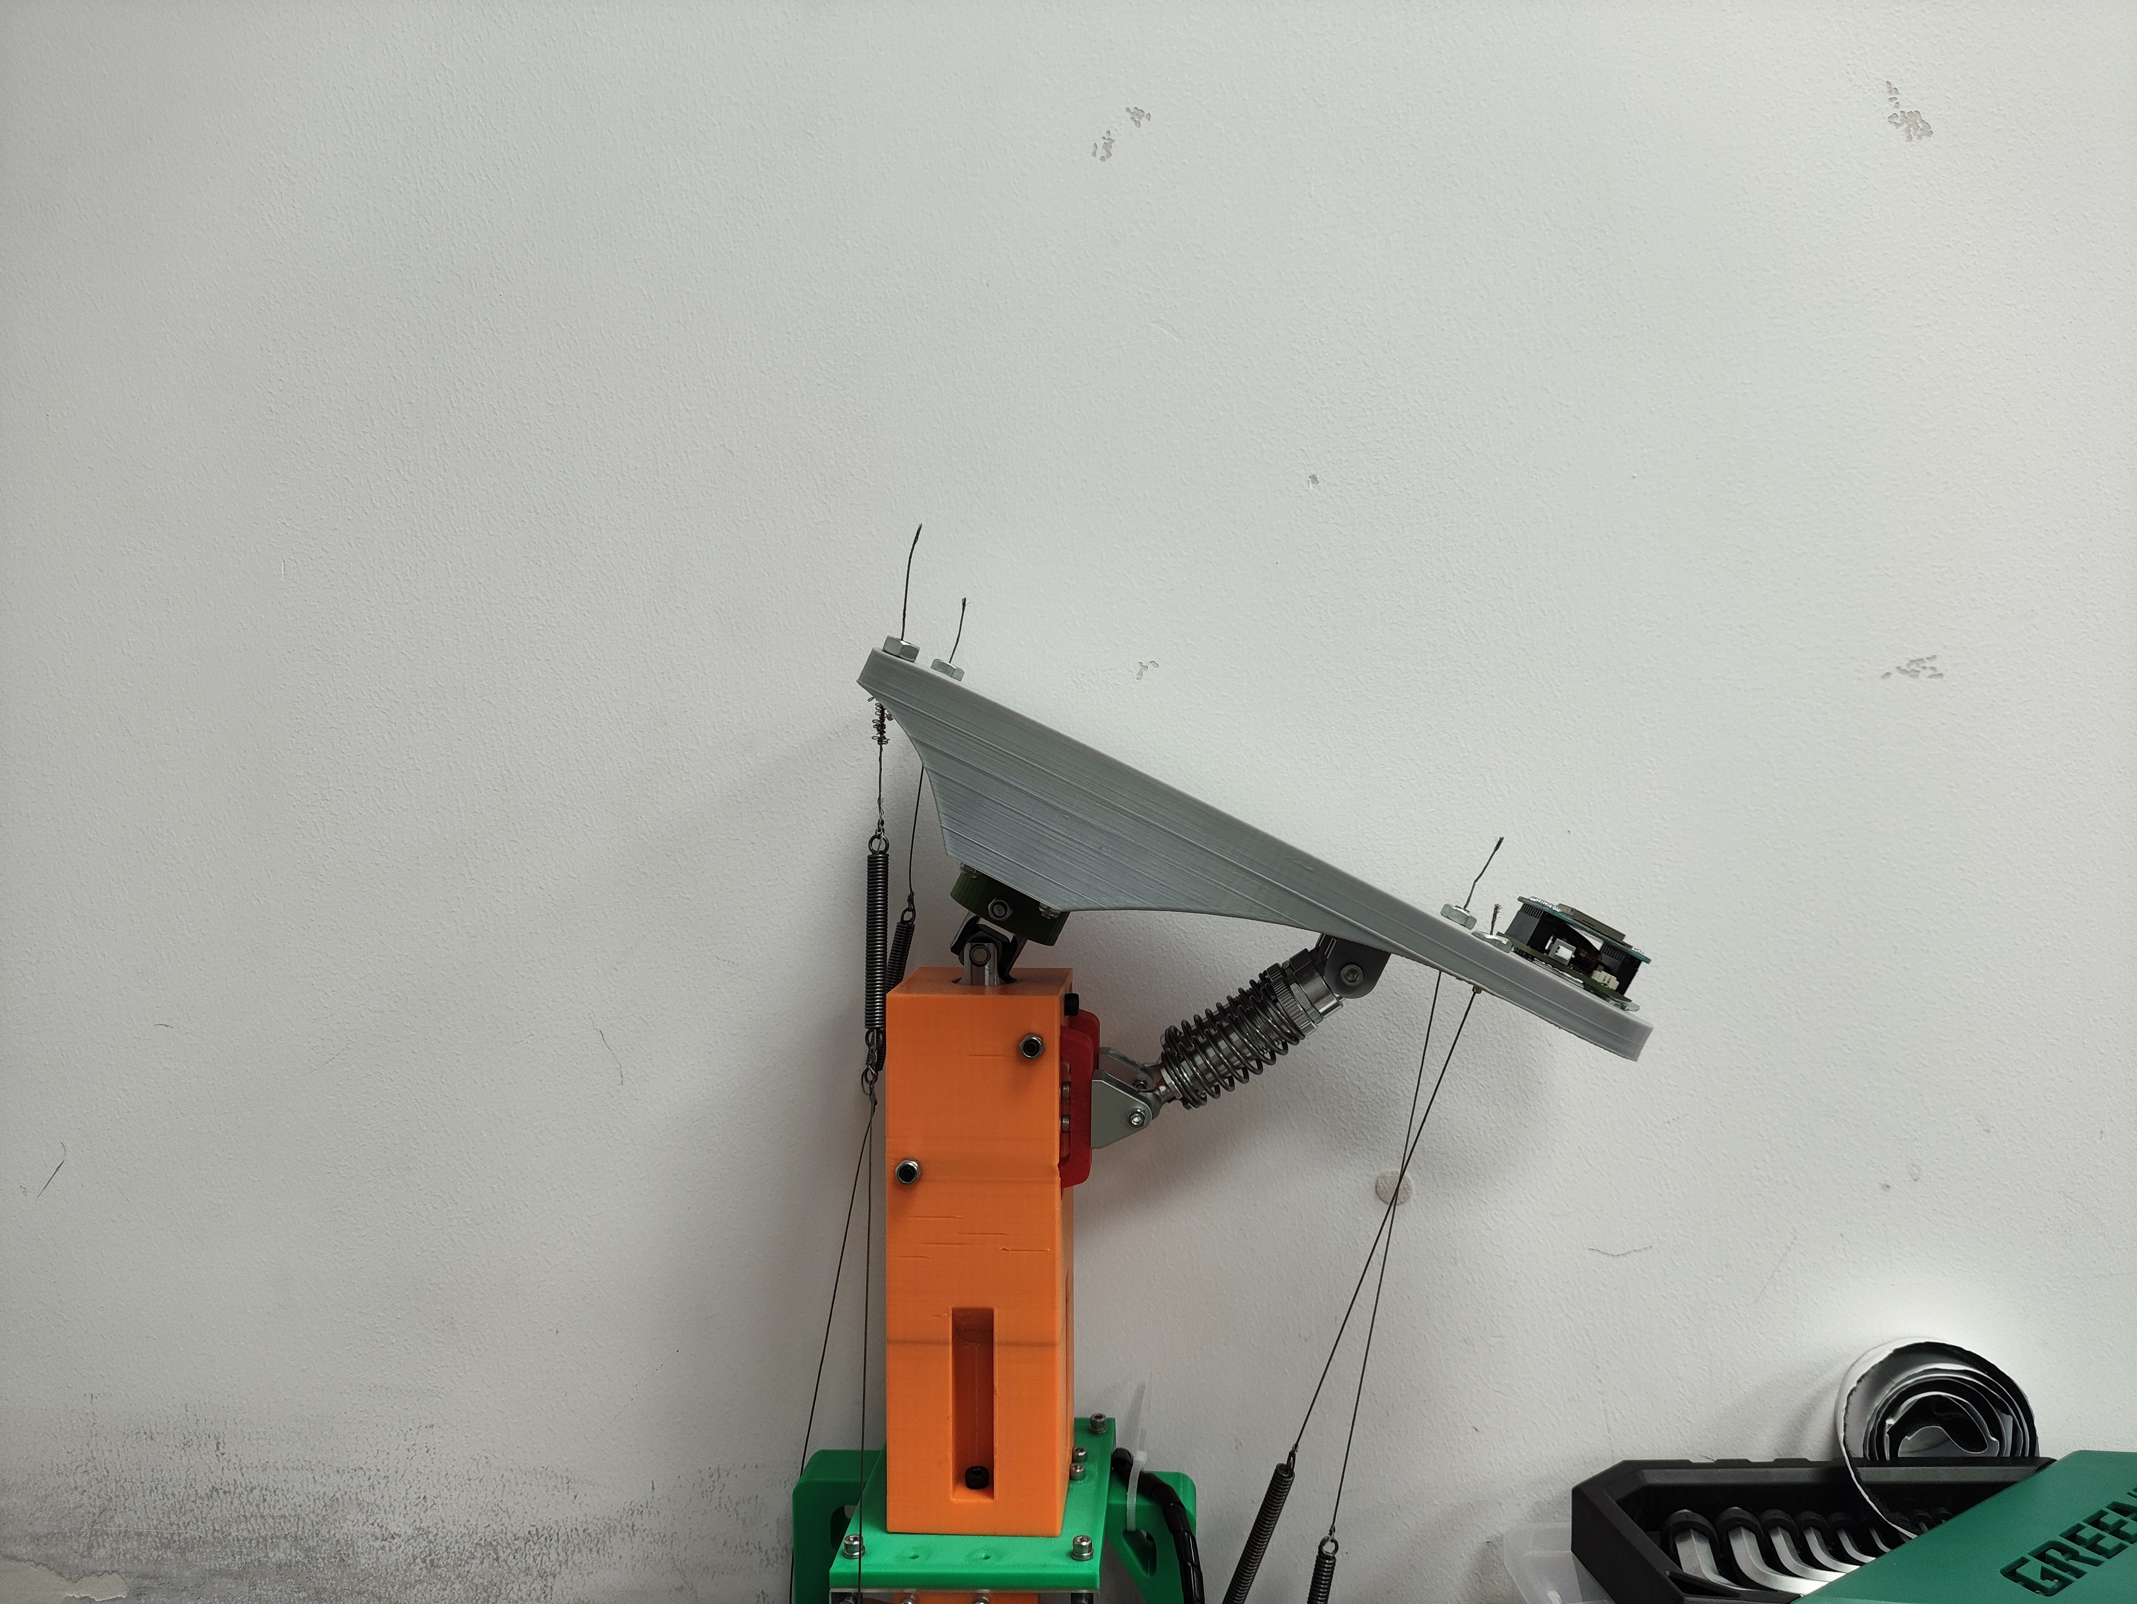
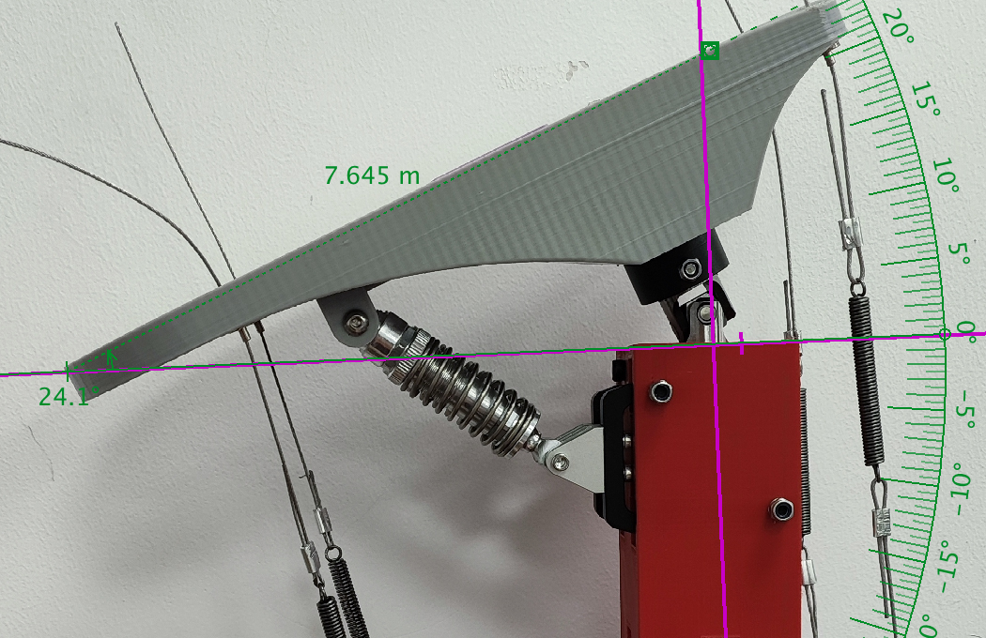
First model Second Model
I started on the first prototype of the bionic ankle to work on the code.
4.5 – 6.24
3D printed materials cannot withstand the force exerted by the motors, so aluminium boards are needed.
A damping is needed to use up the additional motors force.
6.24 - now

Slide 8
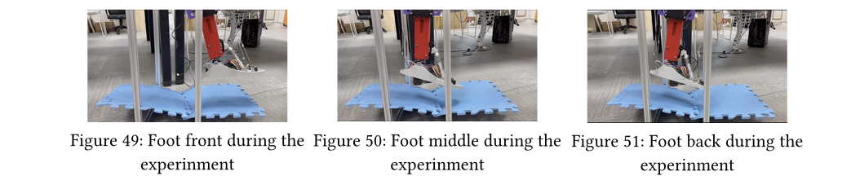
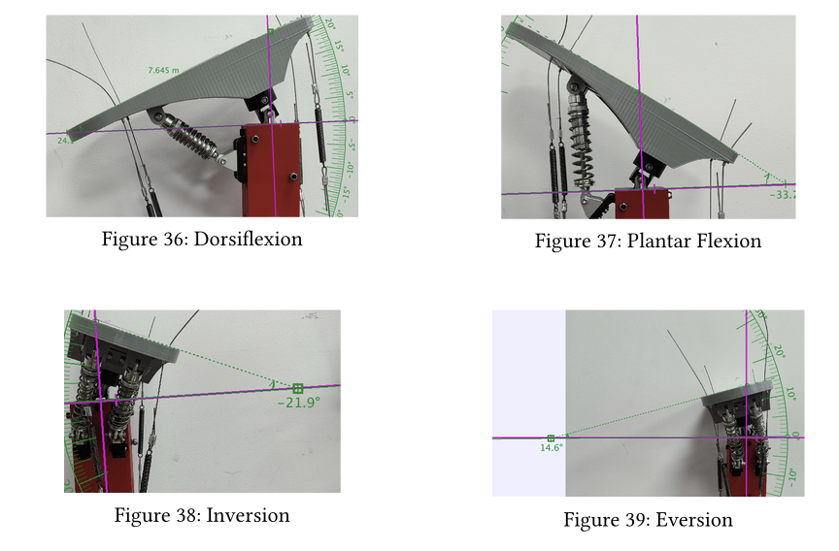
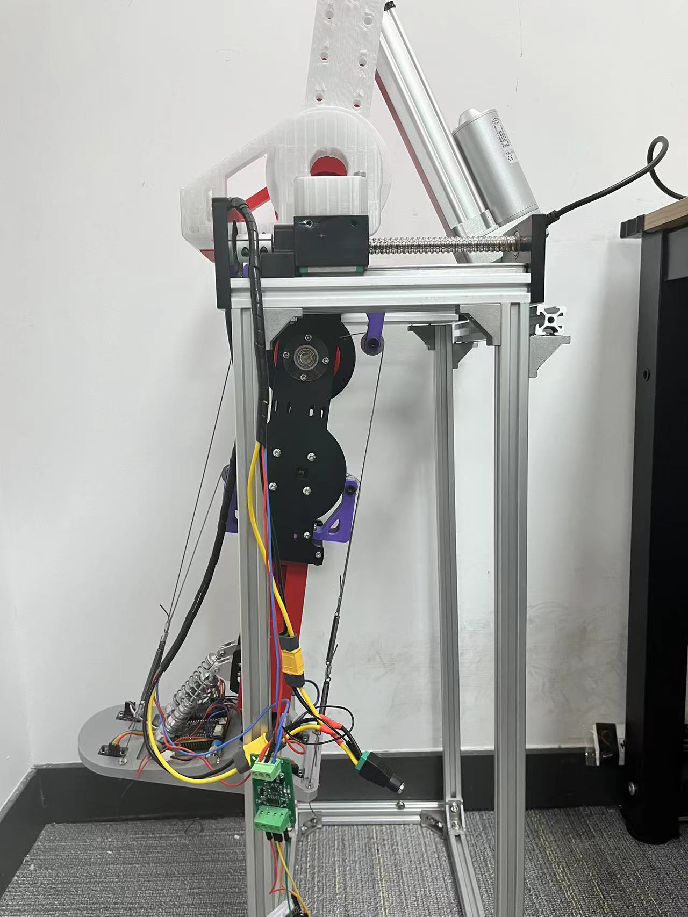
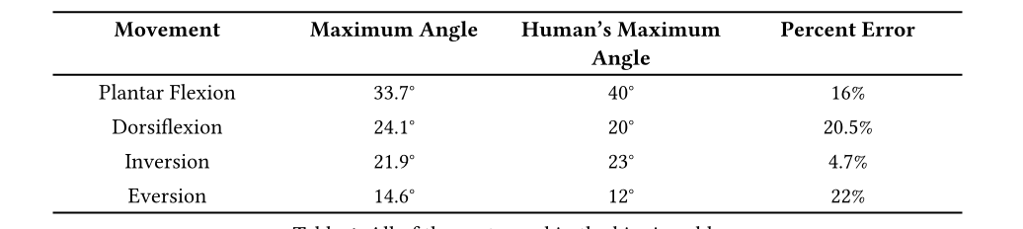
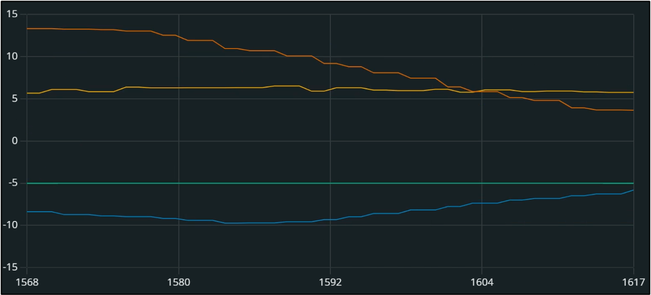
Maximum Angle Self-adaptive Experiments

Slide 9
Future Improvements
In this prototype, we have sucessfully demonstarted the basic functions of such 2 dof bionic ankle. Of course, there is still nessary steps for it to be used on robots
Experiment on different foot types for different situations (such as for stability on rough ground)
Coordination of ankle with legs and upper body

Slide 10
Video

Slide 11
Thank You for Listening

